Slide 1
Analysis of Clocked Sequential
Circuits
Goutham Makkena

Slide 2

Clocked Sequential Circuits
Analysis describes what a given circuit will do under certain operating conditions
The behaviour of a clocked sequential circuit is determined from the inputs, the outputs, and the state of its flip-flops.
The outputs and the next state are both a function of the inputs and the present state.
The analysis of a sequential circuit consists of obtaining equations, table and a diagram for the time sequence of inputs, outputs, and internal states.

Slide 3
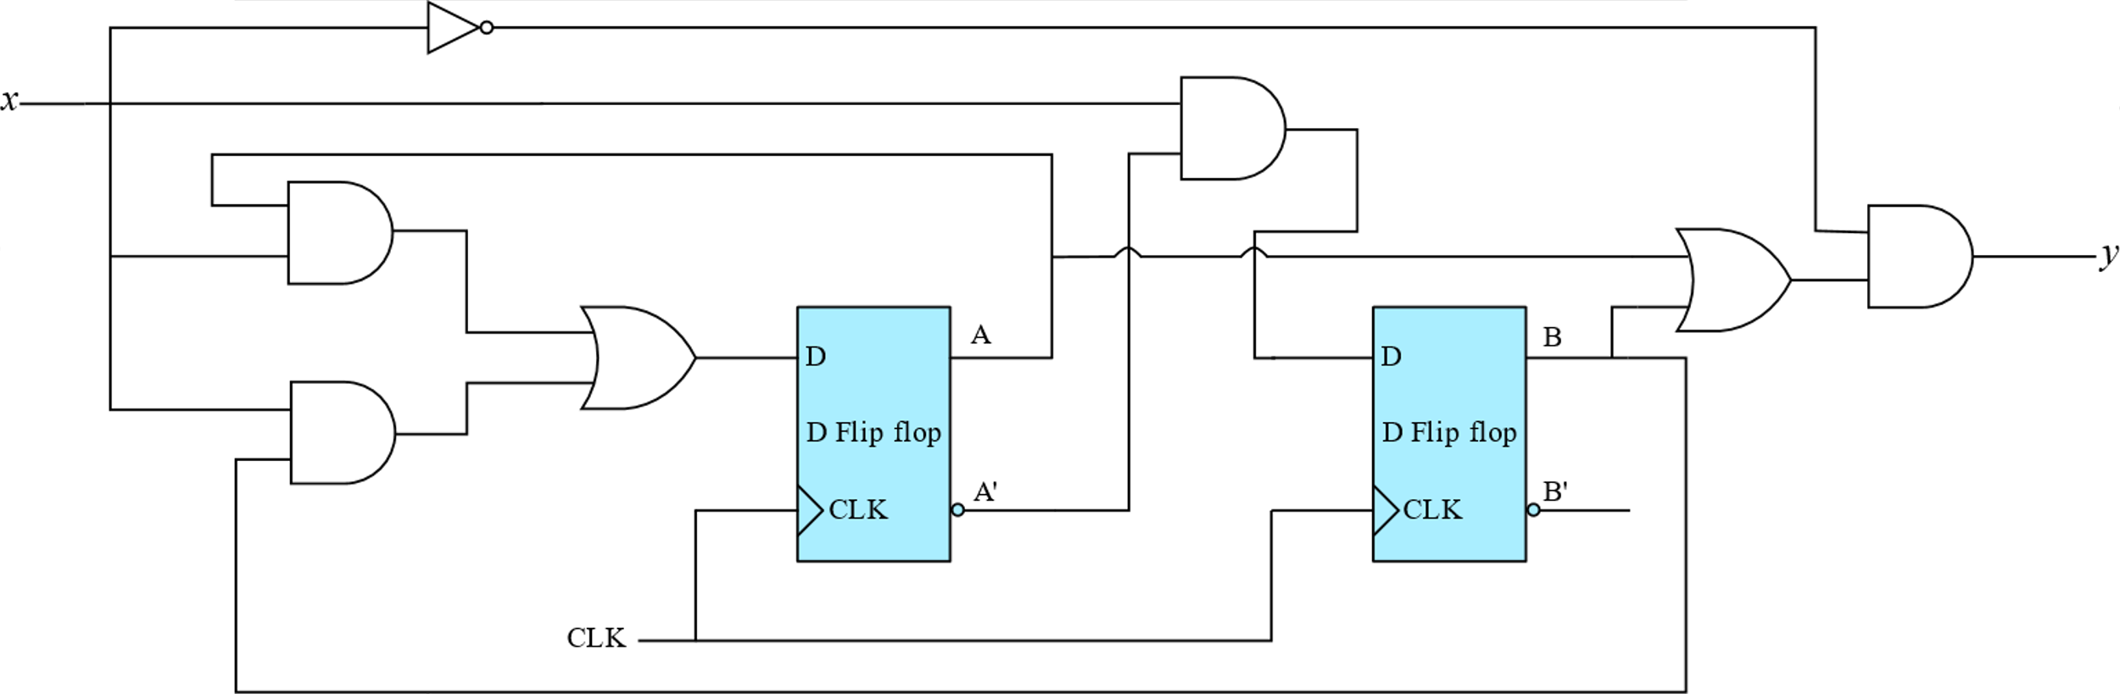
Clocked Sequential Circuits
State Equations
The behaviour of a clocked sequential circuit can be described algebraically by means of state equations
The state equation specifies next state as a function of the present state and inputs.

Slide 4
State Equations
The above circuit consists of 2 D-flip flops A,B, one input x and one output y
The D input of a flip-flop determines the value of the next state (i.e, the state reached after the clock transition). A set of state equations can now be written as
A(t+1) = $A\left(t\right)x\left(t\right)+B\left(t\right)x(t)$
B(t+1) = $A′\left(t\right)x\left(t\right)$
y(t)= $[A\left(t\right)+B(t)]x′\left(t\right)$

Slide 5
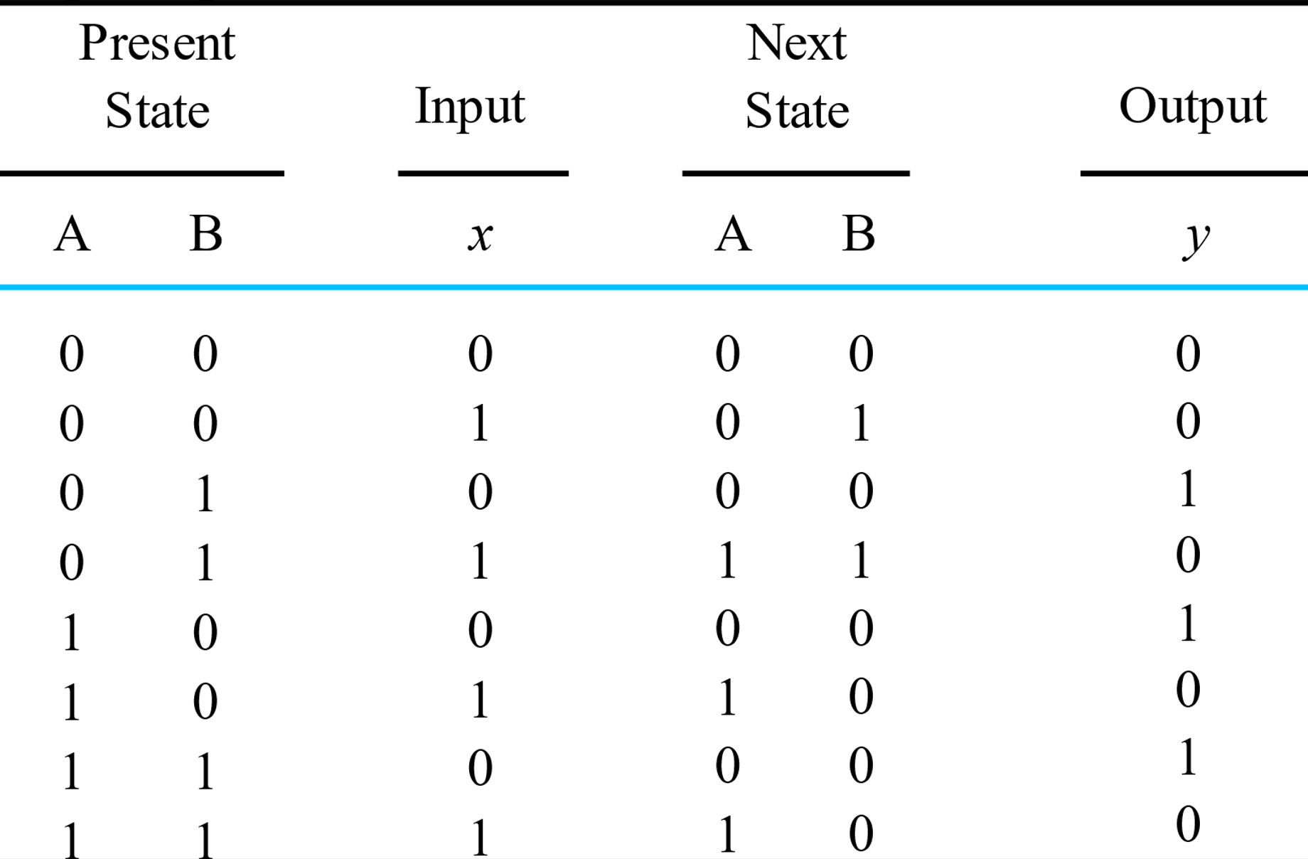
State Table
The state table consists of four sections, present state, input next state and output. This table can be easily obtained with the help of state equations

Slide 6
State Diagram
The information in the state table can be conveyed graphically by a state diagram
A state is denoted by a circle with a binary number inside it
Clock triggered transitions between the states are indicated by directed lines connecting the circles
The directed lines are labeled with two binary numbers separated by a slash
The input value during the present state is labeled first, and the number after the slash gives the output during the present state with the given input

Slide 7



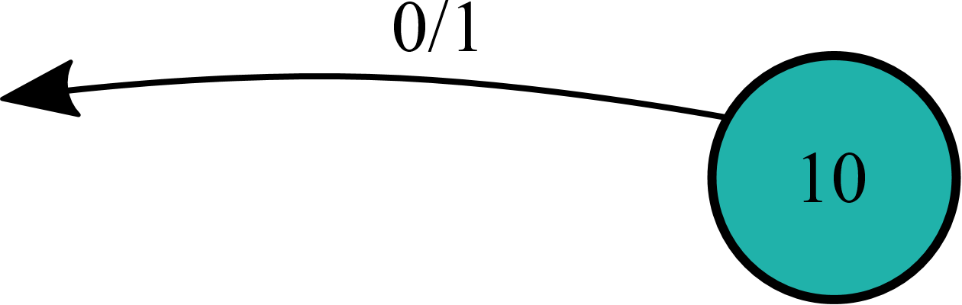
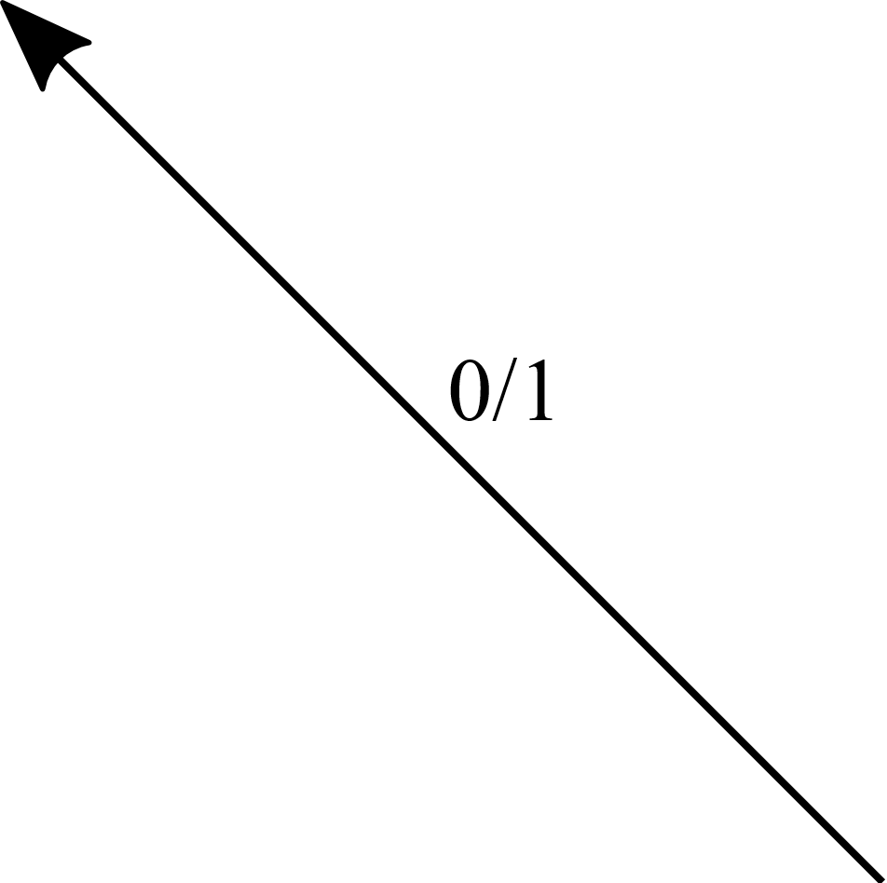
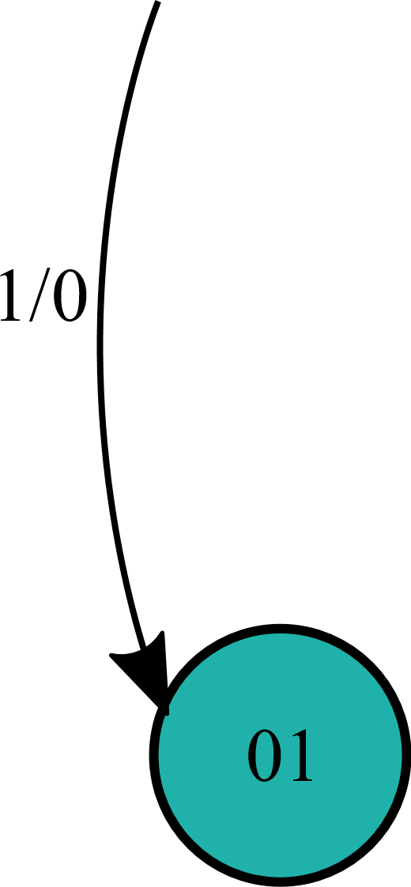



State Diagram

Slide 8
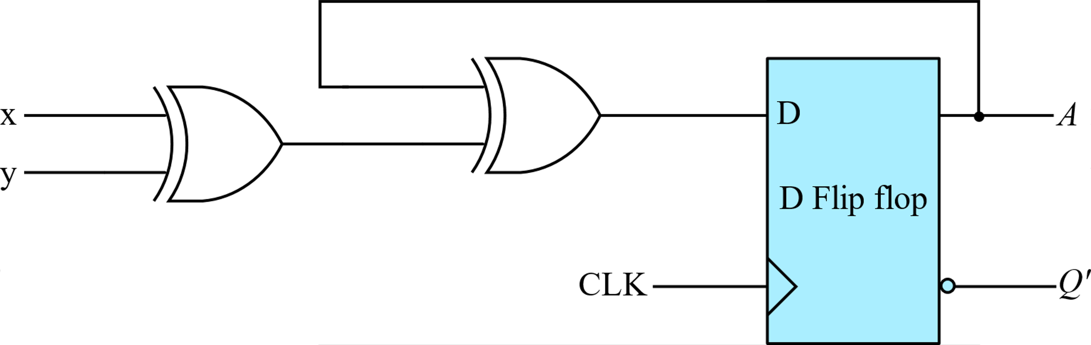
Analysis of Sequential Circuits
Obtain the state equations, state table and state diagram for the above sequential circuit
The above sequential circuit has one D flip flop, two inputs x,y
A(t+1) = $x⊕y⊕A(t)$

Slide 9
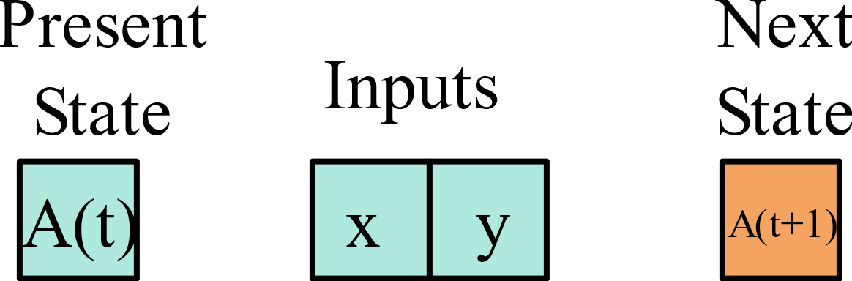




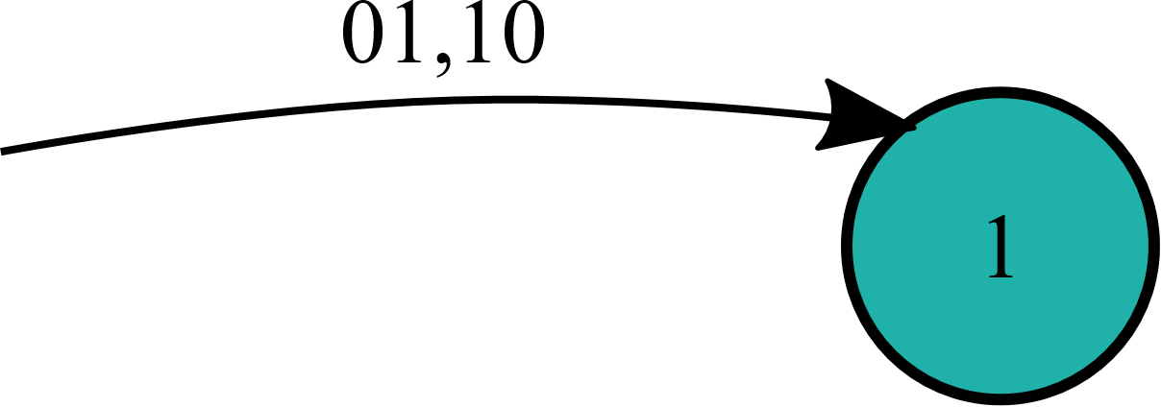













State Table
A(t+1) = $x⊕y⊕A(t)$

Slide 10
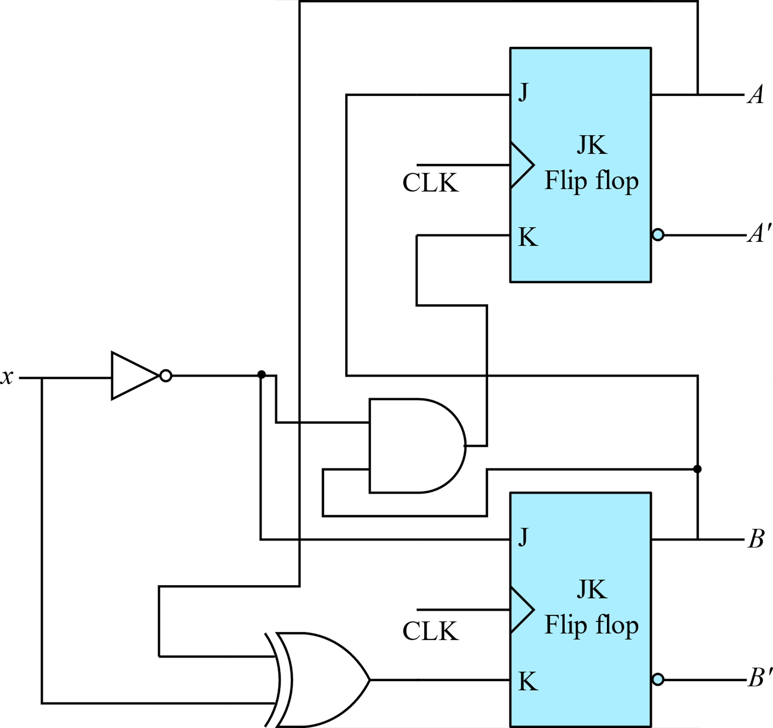
Analysis with JK Flip Flops

Slide 11
Analysis with JK Flip Flops
For a D-type flip-flop, the state equation is the same as the input equation.
When a flip-flop other than the D type is used, such as JK or T, it is necessary to refer to the corresponding characteristic table

Slide 12
Analysis with JK Flip Flops
Flip-flop input equations
JA = B
KA = B x’
JB = x’
KB = A $⊕$ x

Slide 13
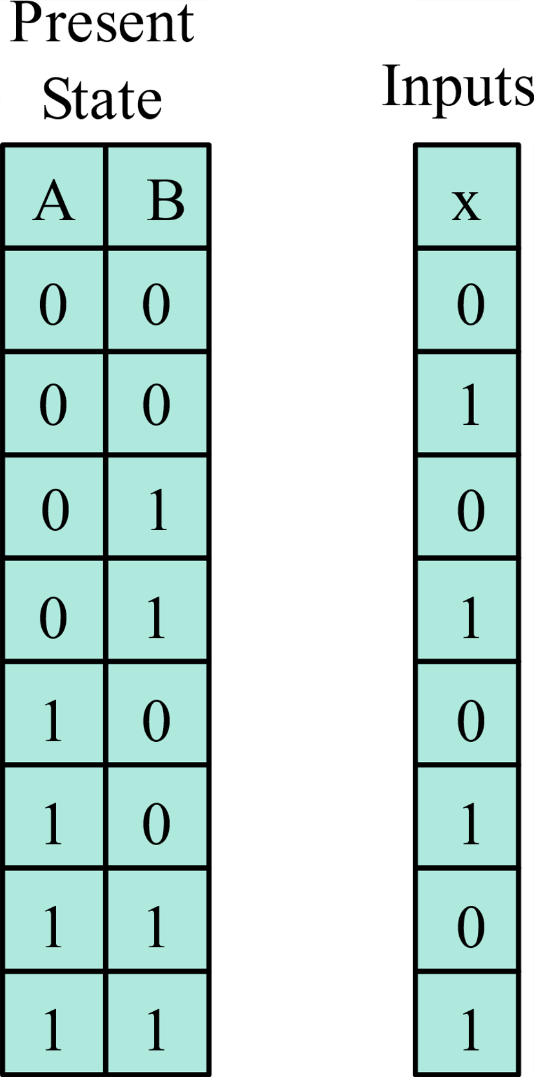

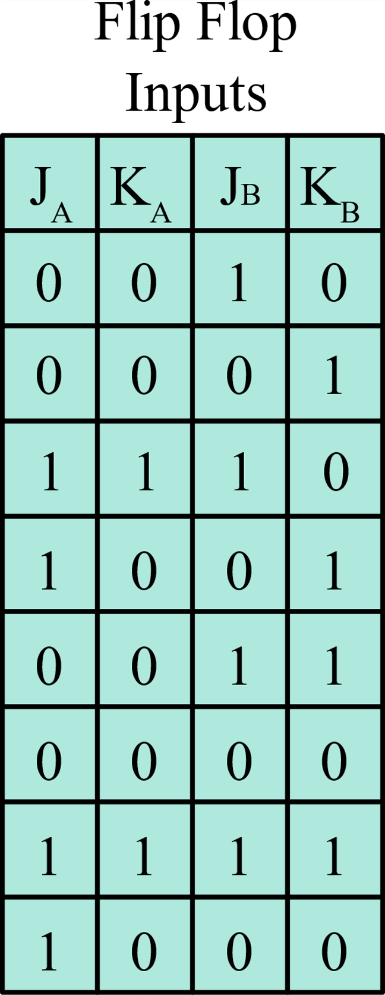
Analysis with JK Flip Flops
Flip-flop input equations
KA = B x’
JA = B
JB = x’
KB = A $⊕$ x

Slide 14


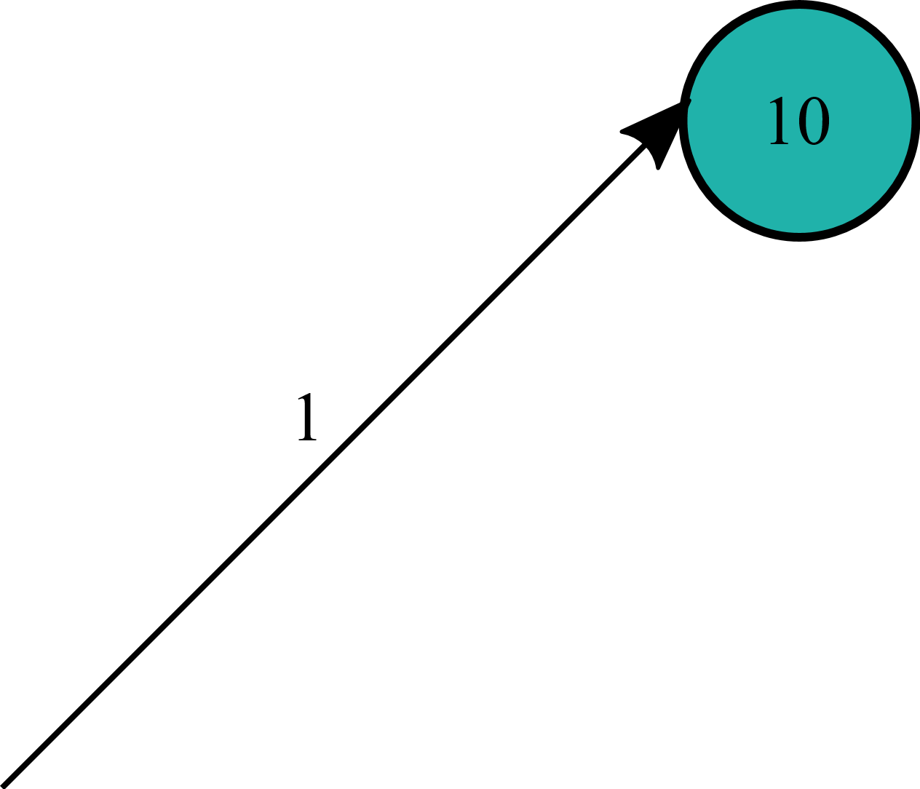
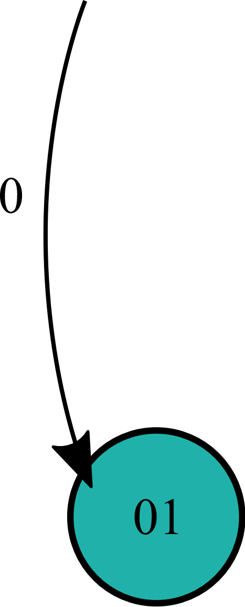
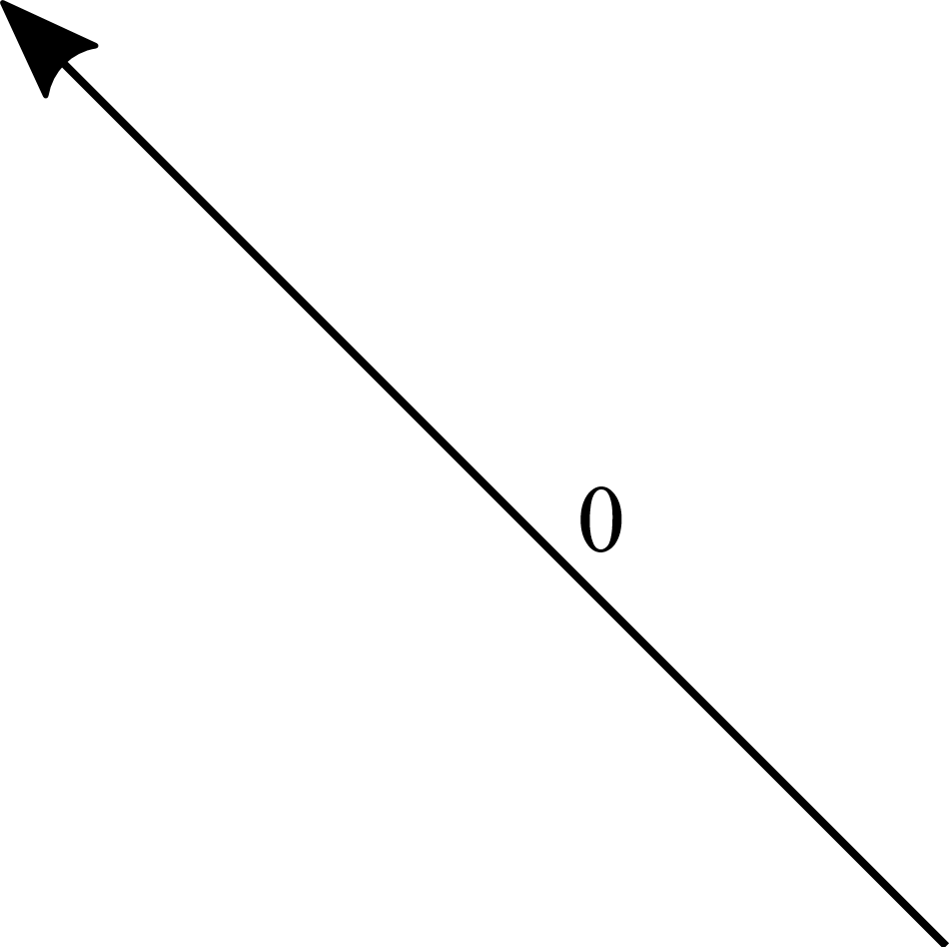



Analysis with JK Flip Flops

Slide 15
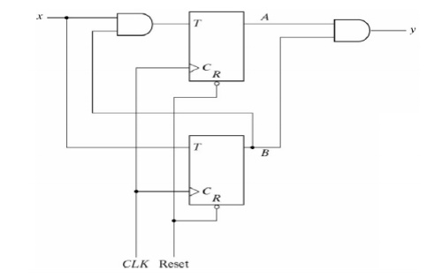

Slide 16
Mealy and Moore Models of Finite State Machines
A sequential circuit has inputs, outputs, and internal states.
There are two models of sequential circuits: the Mealy model and the Moore model
They differ only in the way the output is generated
In the Mealy model, the output is a function of both the present state and the input
In the Moore model, the output is a function of only the present state

Slide 17
Mealy and Moore Models of Finite State Machines
A sequential circuit has inputs, outputs, and internal states.
There are two models of sequential circuits: the Mealy model and the Moore model
They differ only in the way the output is generated
In the Mealy model, the output is a function of both the present state and the input
In the Moore model, the output is a function of only the present state

Slide 18
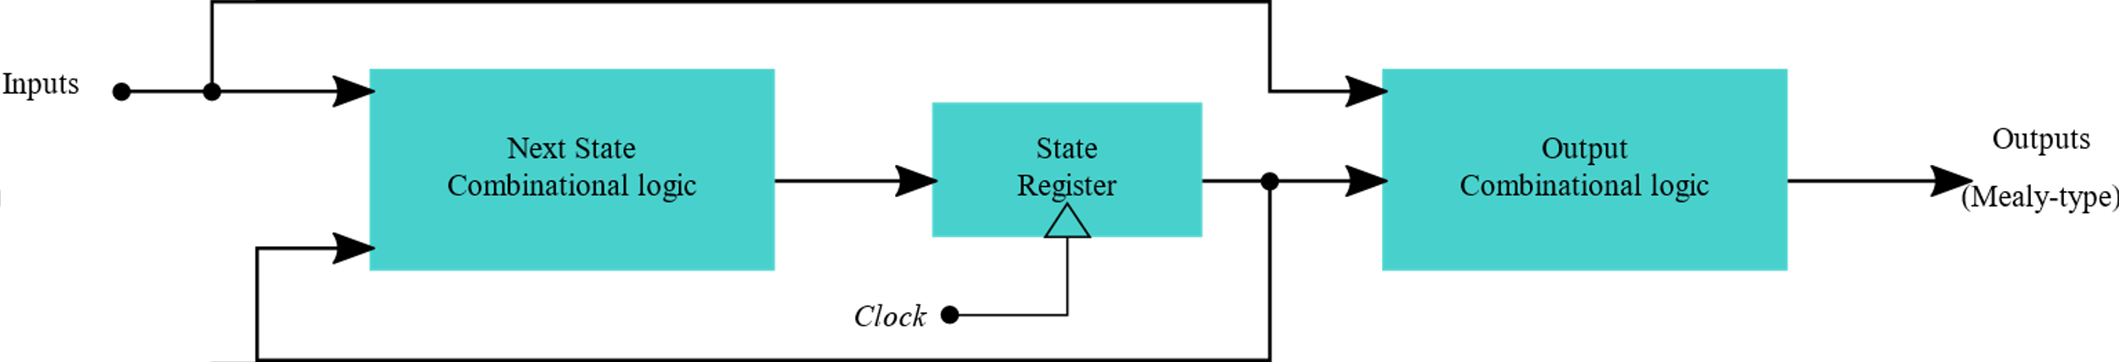
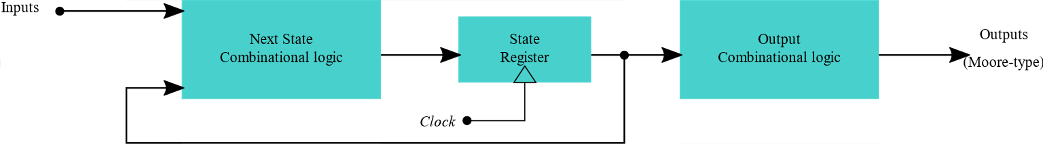
Mealy and Moore machines
Block diagram of a Mealy Machine
Block diagram of a Moore Machine

Slide 19
Mealy machine
The above state machine is Mealy type because the output “y” is a function of present states and input “x”

Slide 20
Mealy machine
The above state machine is Mealy type because the output “y” is a function of present states and input “x”

Slide 21
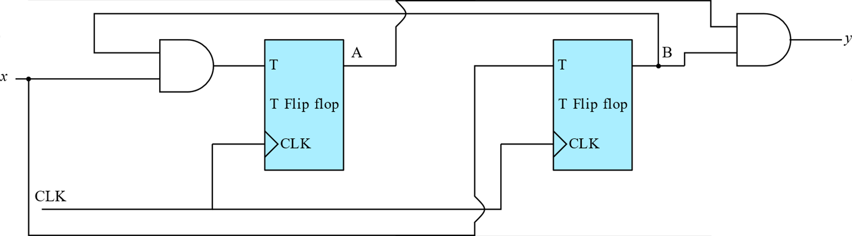
Moore machine
The above state machine is Moore type because the output “y” is a function of present states “A” and “B” only
Obtain the flip flop input equations, output equation, state table and state diagram of the above circuit

Slide 22
Moore machine
TA = Bx
TB = x
Y = AB

Slide 23
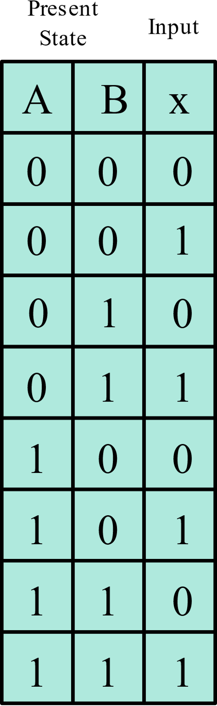
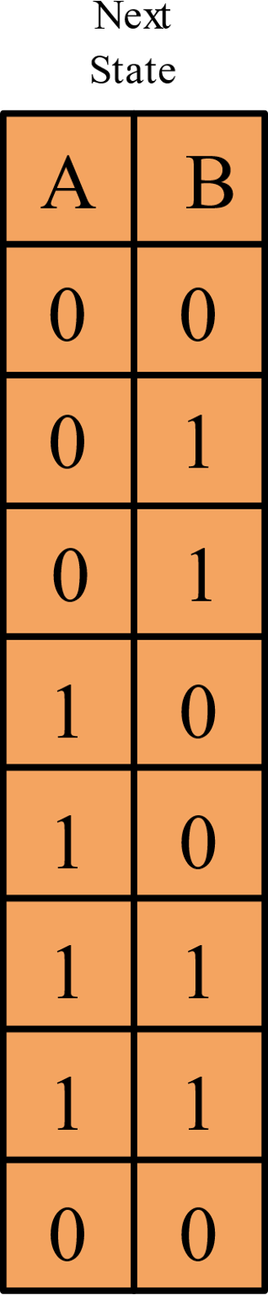
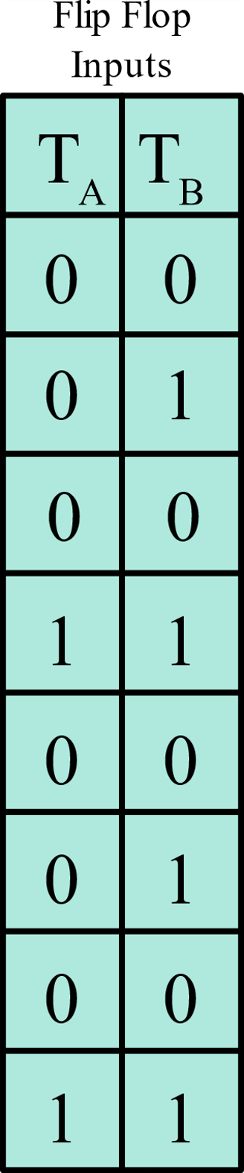

Moore machine
TA = Bx
TB = x
Y = AB

Slide 24



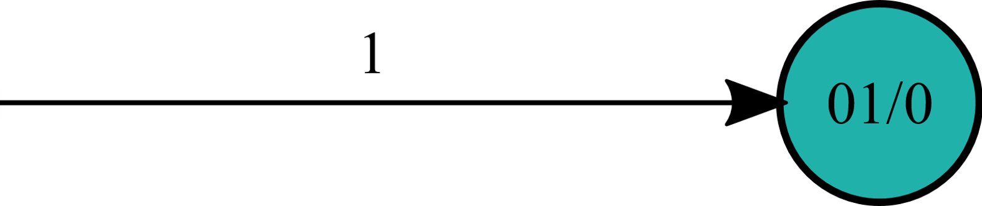



Moore machine
The input value in the state diagram is labeled along the directed line, but the output value is indicated inside the circle together with the present state.

Slide 25
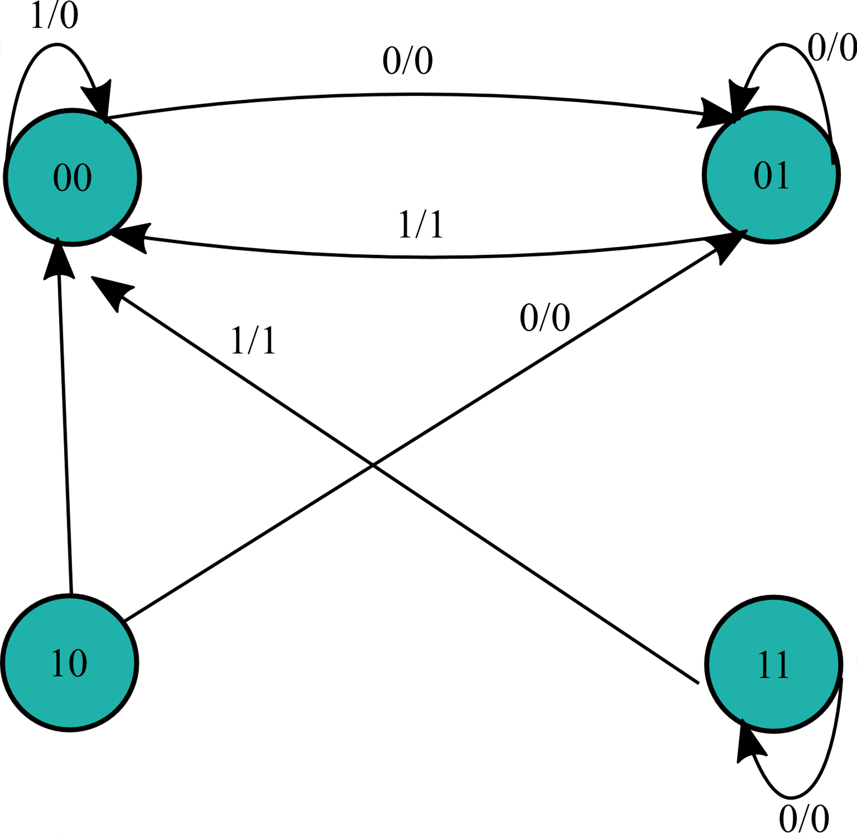

State diagram to logic diagram
From the below state diagram obtain the state table and implement the logic circuit using
D flip flops

Slide 26
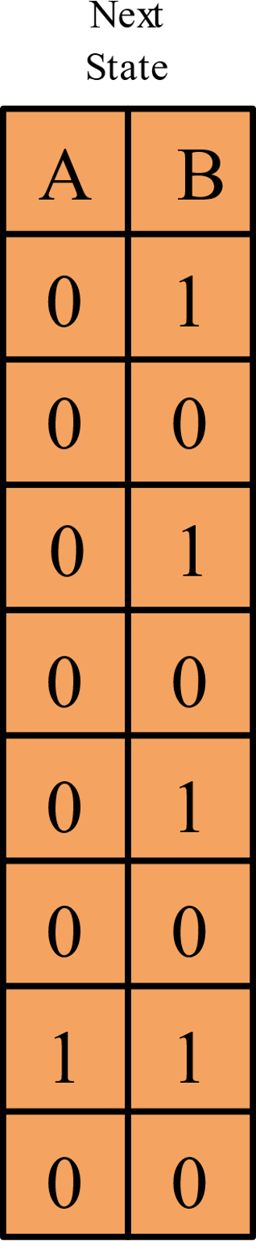

State diagram to logic diagram

Slide 27
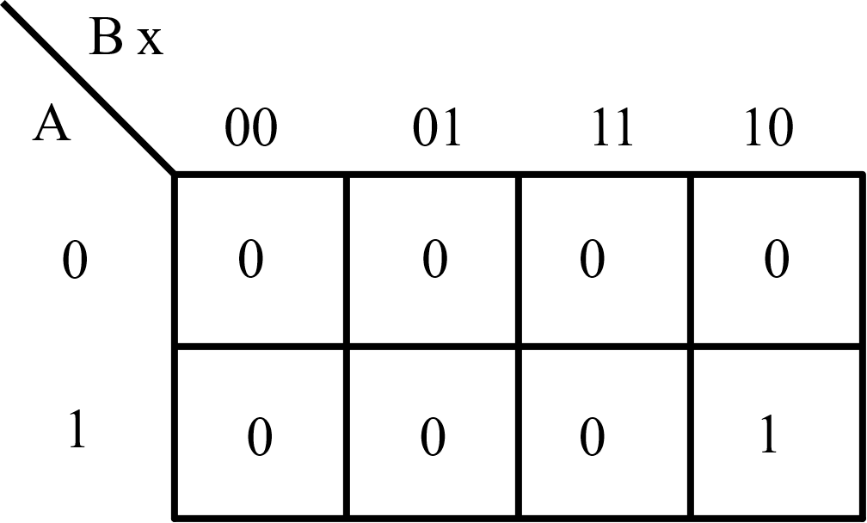

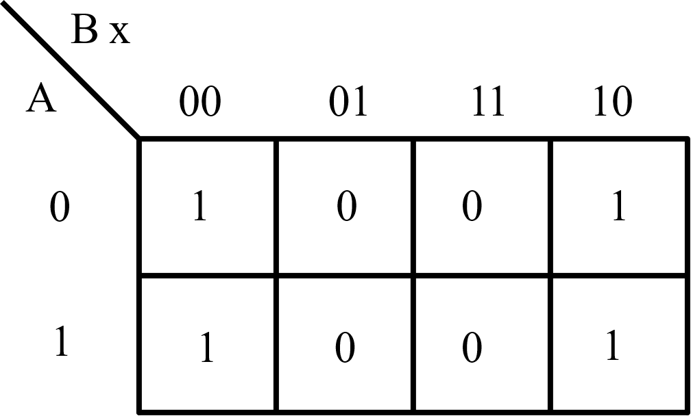

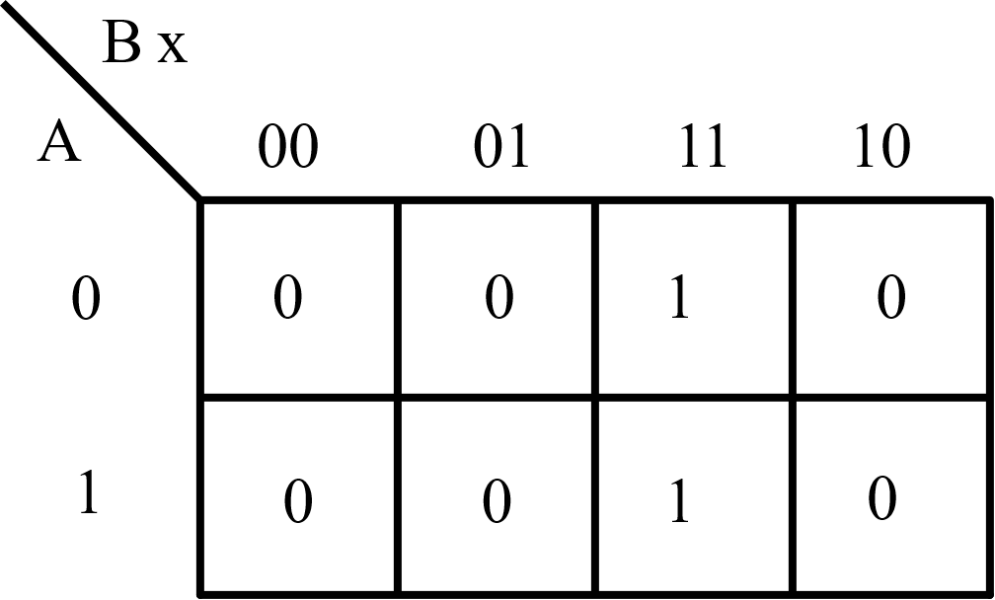

State diagram to logic diagram
DA
DA = ABx’
DB
DB = x’
y
y = Bx

Slide 28
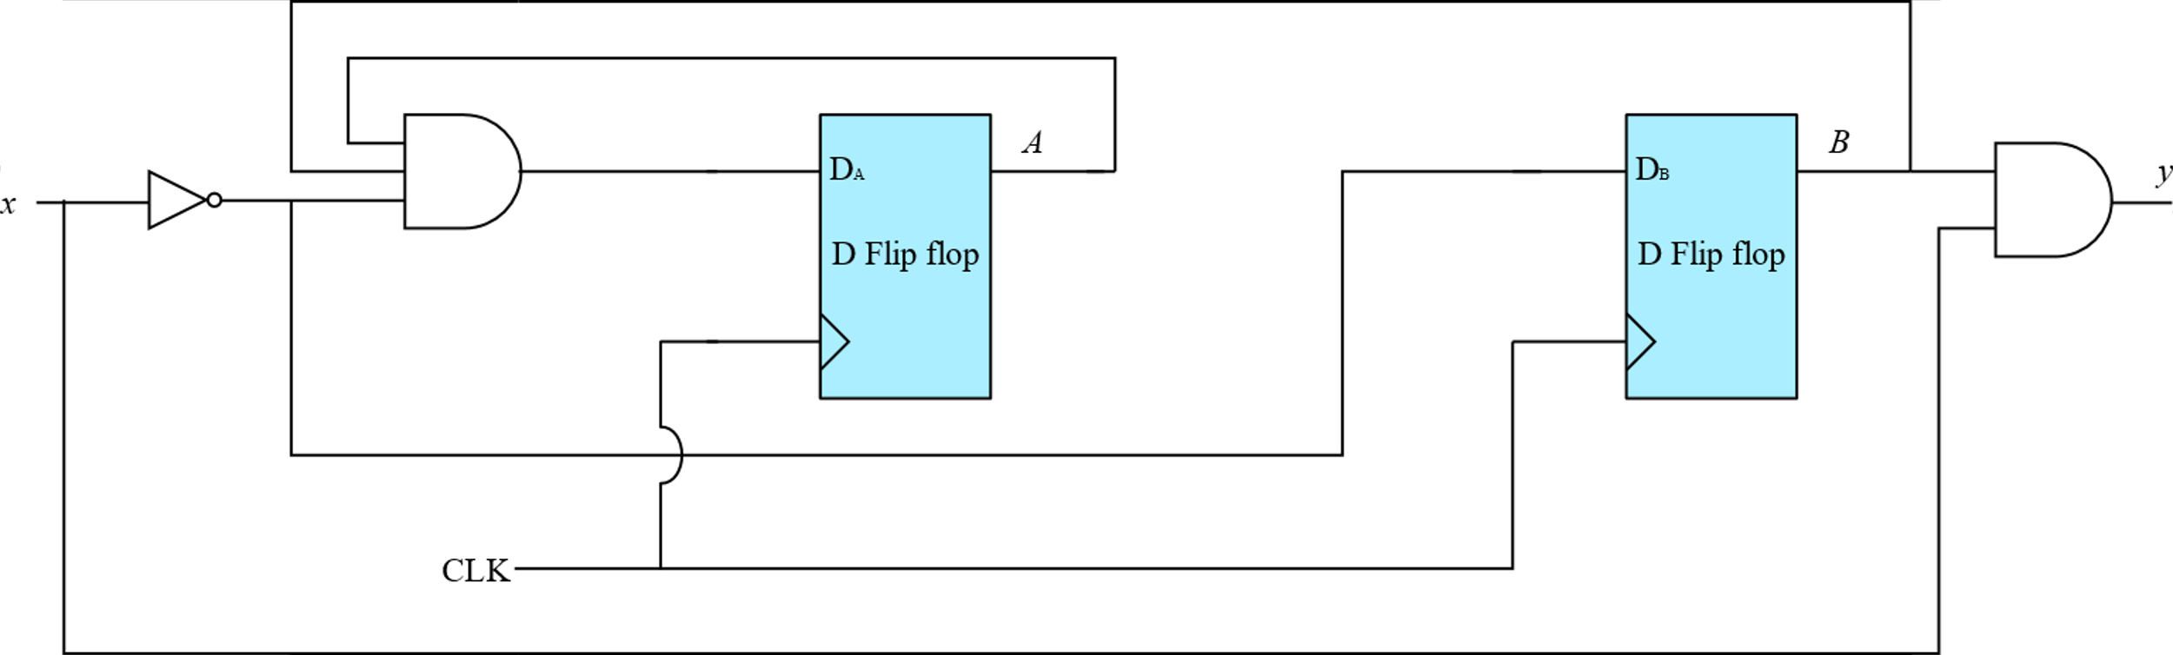
State diagram to logic diagram

Slide 29
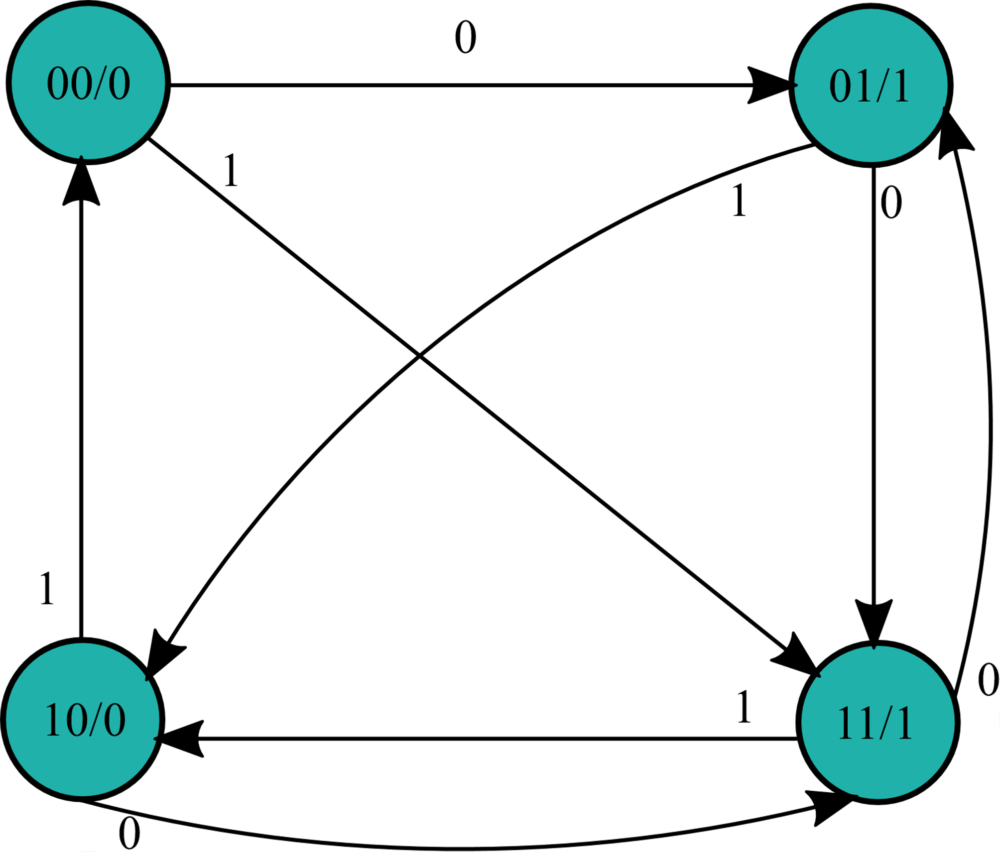
State diagram to logic diagram
From the above state diagram obtain the state table and implement the logic circuit using
T flip flops

Slide 30
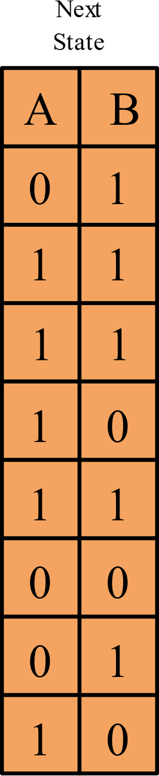

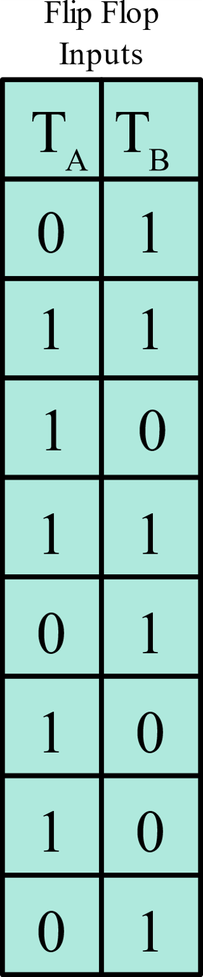
State diagram to logic diagram

Slide 31
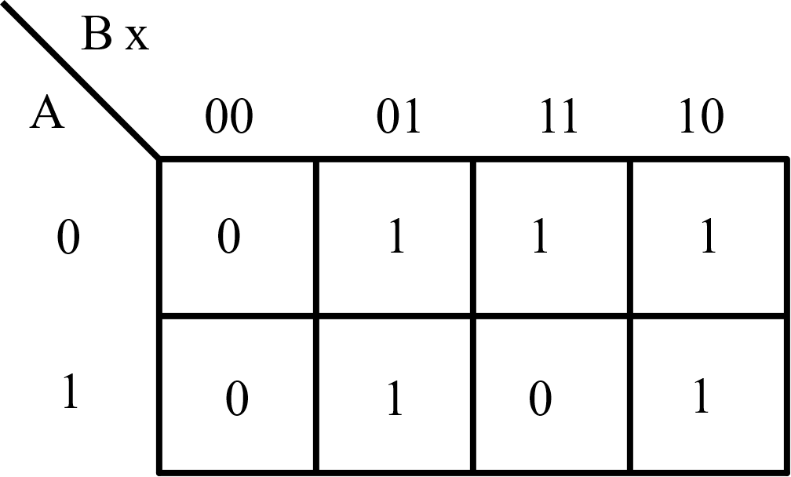


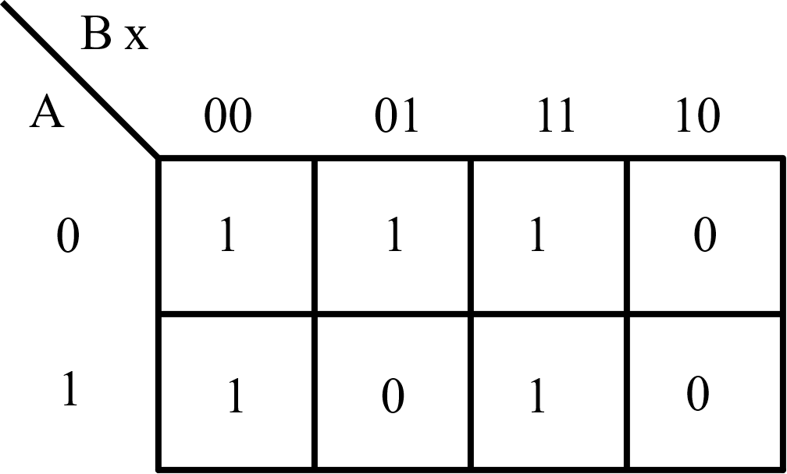
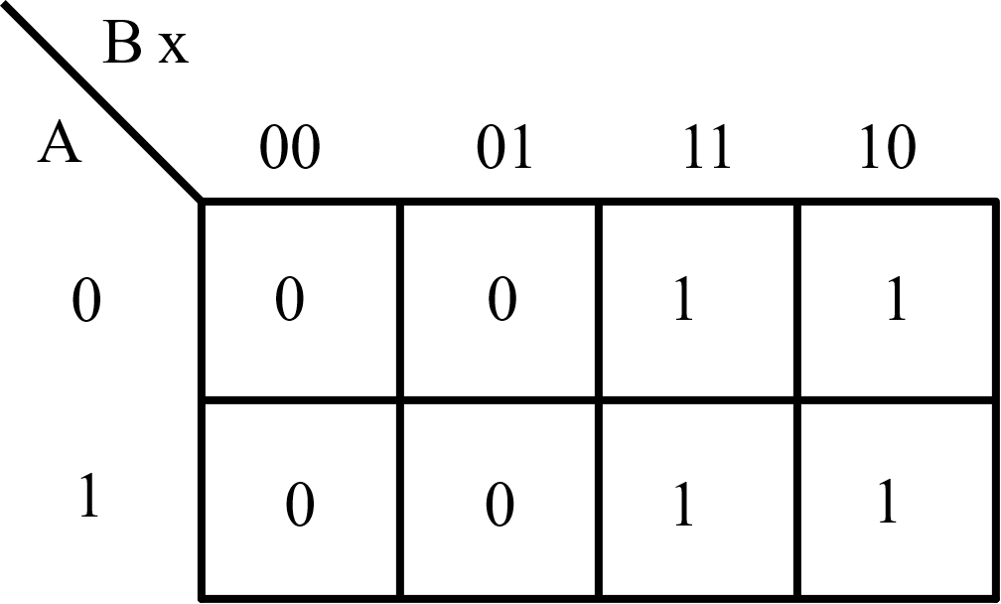

State diagram to logic diagram
TA
TA = B’x + A’B + Bx’
TB
TB = B’x’ + A’B’ + Bx
y
y=B

Slide 32
State Machines
So far, we have analysed a given state machine by writing its state equations, listing the state tables and drawing state diagrams
Similarly, we also converted a given state diagram to logic using flip flops and gates
The ultimate skill to develop now is to convert a verbal description to a state diagram and obtain the relevant logic using flip flops
Let us now construct a simple coca-cola vending machine!!!!

Slide 33
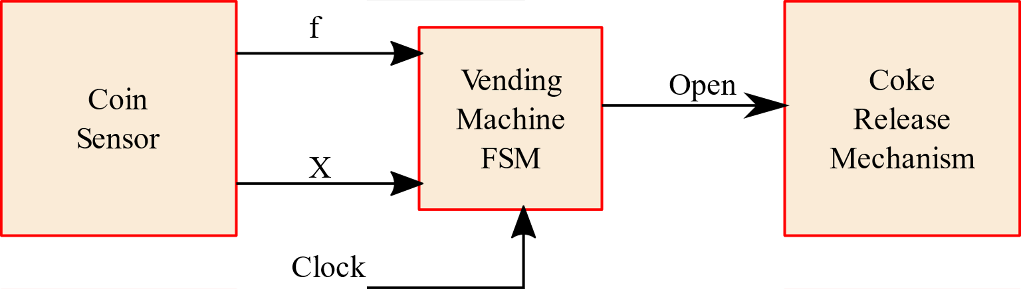
State Machines
Here is how the vending machine is supposed to work
The vending machine delivers the cool drink after it receives 15 ₹ in coins
The machine has a single coin slot and it accepts only 5 ₹ and 10 ₹ coins, one coin at a time
A sensor inside the machine indicates whether 5 ₹ coin or 10 ₹ coin has been inserted
Ours is a greedy machine and it does not deliver change!!!

Slide 34



State Machines

Slide 35



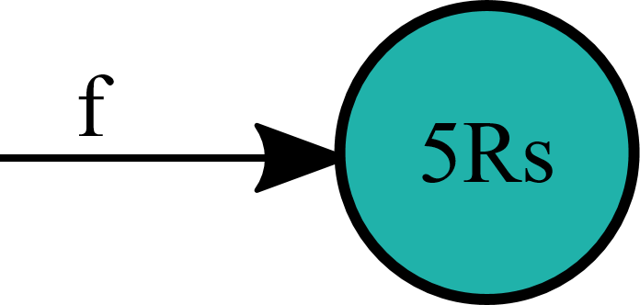
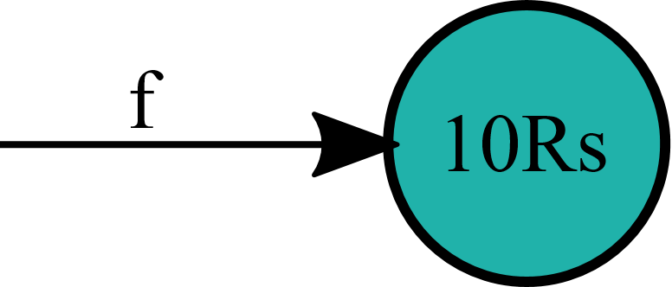
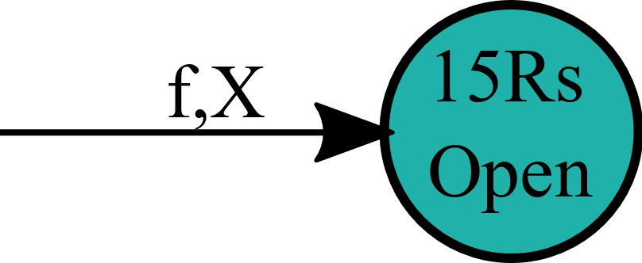

State diagram of vending machine
Our coca cola vending machine has two inputs, f (indicating a 5Rs coin) and X (indicating a 10Rs coin). It has one output (open, which releases cool drink when 15Rs are inserted)
Every state machine has an initial state or starting point, followed by transition states that perform different actions. A terminal state is the final state executed which usually performs clean up actions

Slide 36
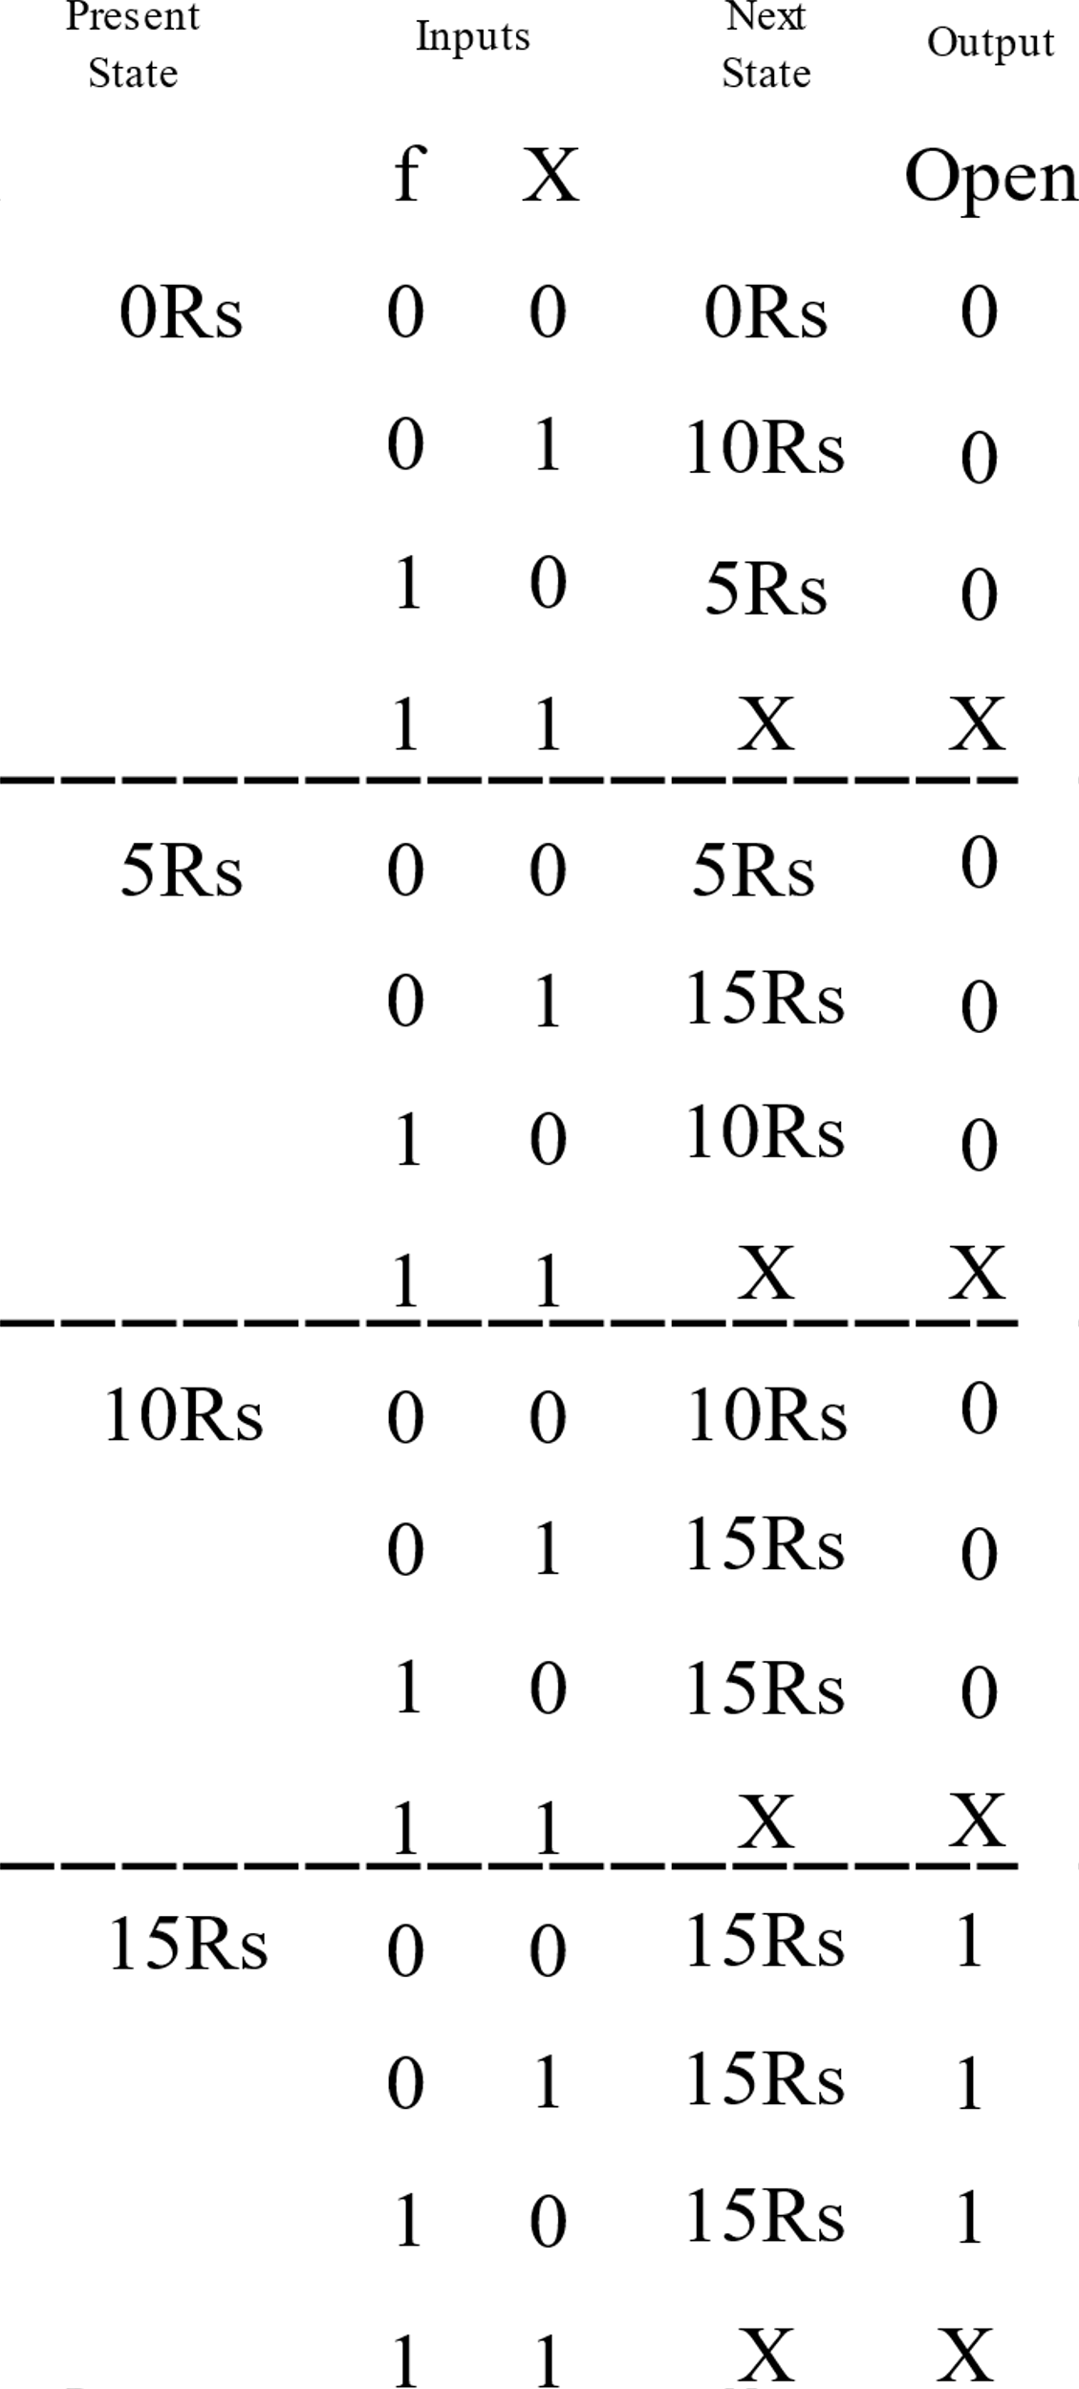
State table of vending machine
Now we have to assign digital values to states. Since 4 states are there 2 bits are required to represent a single state
0Rs 00
5Rs 01
10Rs 10 15Rs 11

Slide 37
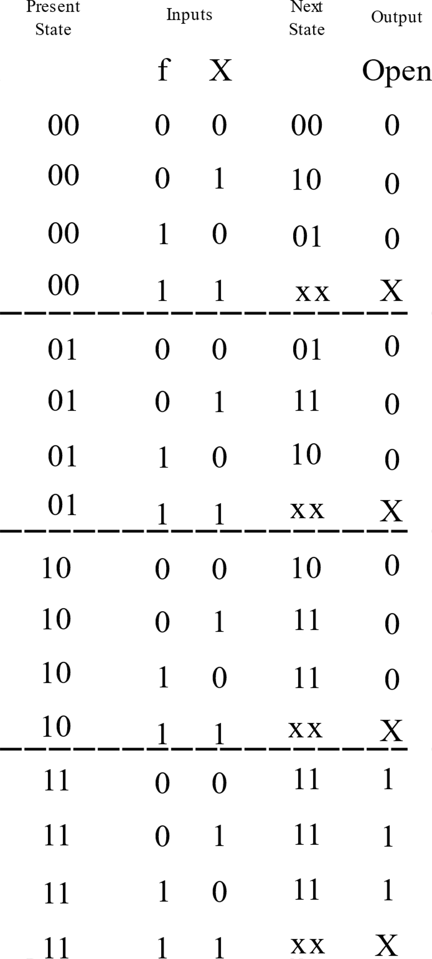
State table of vending machine
Now obtain the expressions for each of the next states as a function of present states and inputs. Then write down the logic diagram

Slide 38
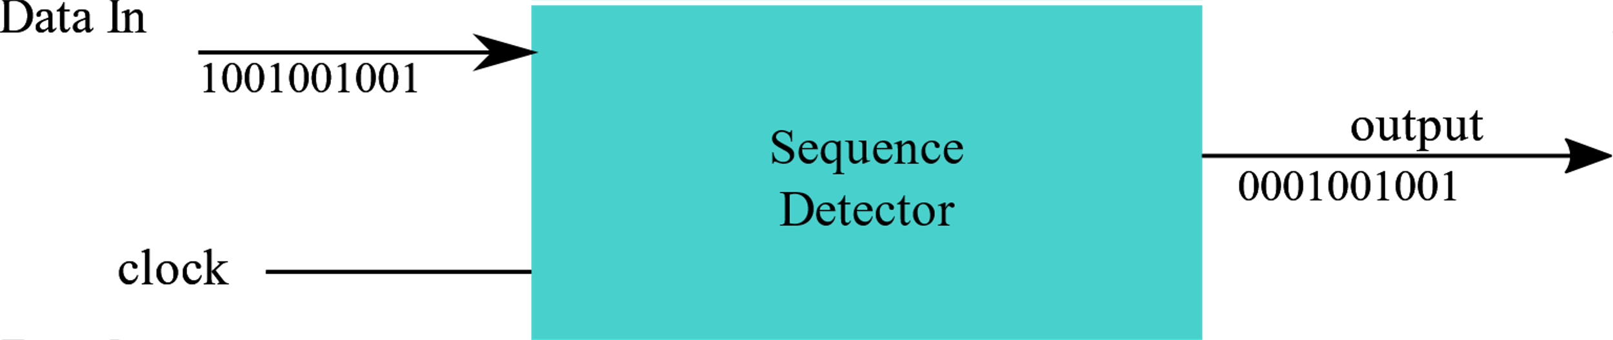
Sequence Detector
A sequence detector is a sequential circuit that outputs 1 when a particular pattern of bits sequentially arrives at its data input
In the sequence detector given above, it detects a sequence 1001 at the input. When input is 1001 in a sequence the output is 1

Slide 39
Sequence Detector
The sequence detector can be designed as a STATE MACHINE
This state machine should “remember” inputs from previous clock cycles
For example, if the previous three inputs were 100 and the current input is 1, then the output should be 1
This state machine should remember occurrences of parts of the desired pattern – in our example it is 1, 10 and 100

Slide 40

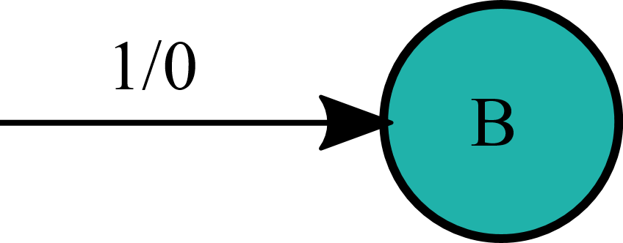
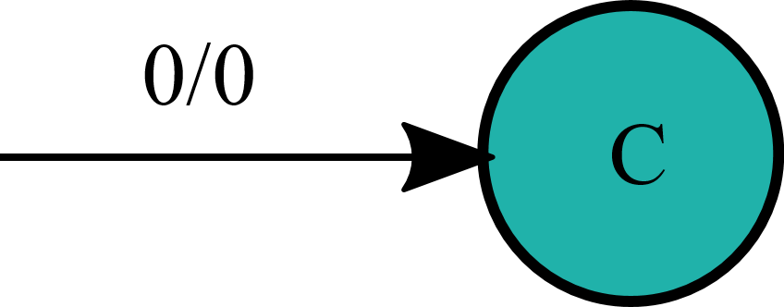
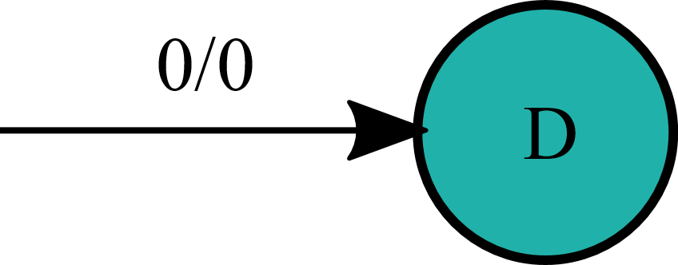
Sequence Detector
Let us start with an initial state or starting state A.
If it is in A and sees a “1”, it progresses towards B. Output is “0”
Now the machine is in state B and sees a “0”, it progresses towards C. Output is “0”
Now the machine is in State C and sees a “0”, it progresses towards D. Output is “0”
State | Meaning
A | None of the desired pattern (1001) has been input yet
B | We have seen the first bit (1) of the desired pattern
C | We have seen the first two bits (10) of the desired pattern
D | We have seen the first three bits (100) of the desired pattern

Slide 41

Sequence Detector
What happens now when we are state D (the last three inputs were 100) and the current input is 1?
- The output should be “1”, because we have found our desired pattern
- The input “1” could also be start of another occurrence of the desired pattern!
For example, 1001001 contains two occurrences of 1001
- To detect overlapping occurrences of the desired pattern, the next state should be B

Slide 42




Sequence Detector
Each state should have two outgoing nodes to account for the possibilities of input X=0 and X=1
State | Meaning
A | None of the desired pattern (1001) has been input yet
B | We have seen the first bit (1) of the desired pattern
C | We have seen the first two bits (10) of the desired pattern
D | We have seen the first three bits (100) of the desired pattern

Slide 43
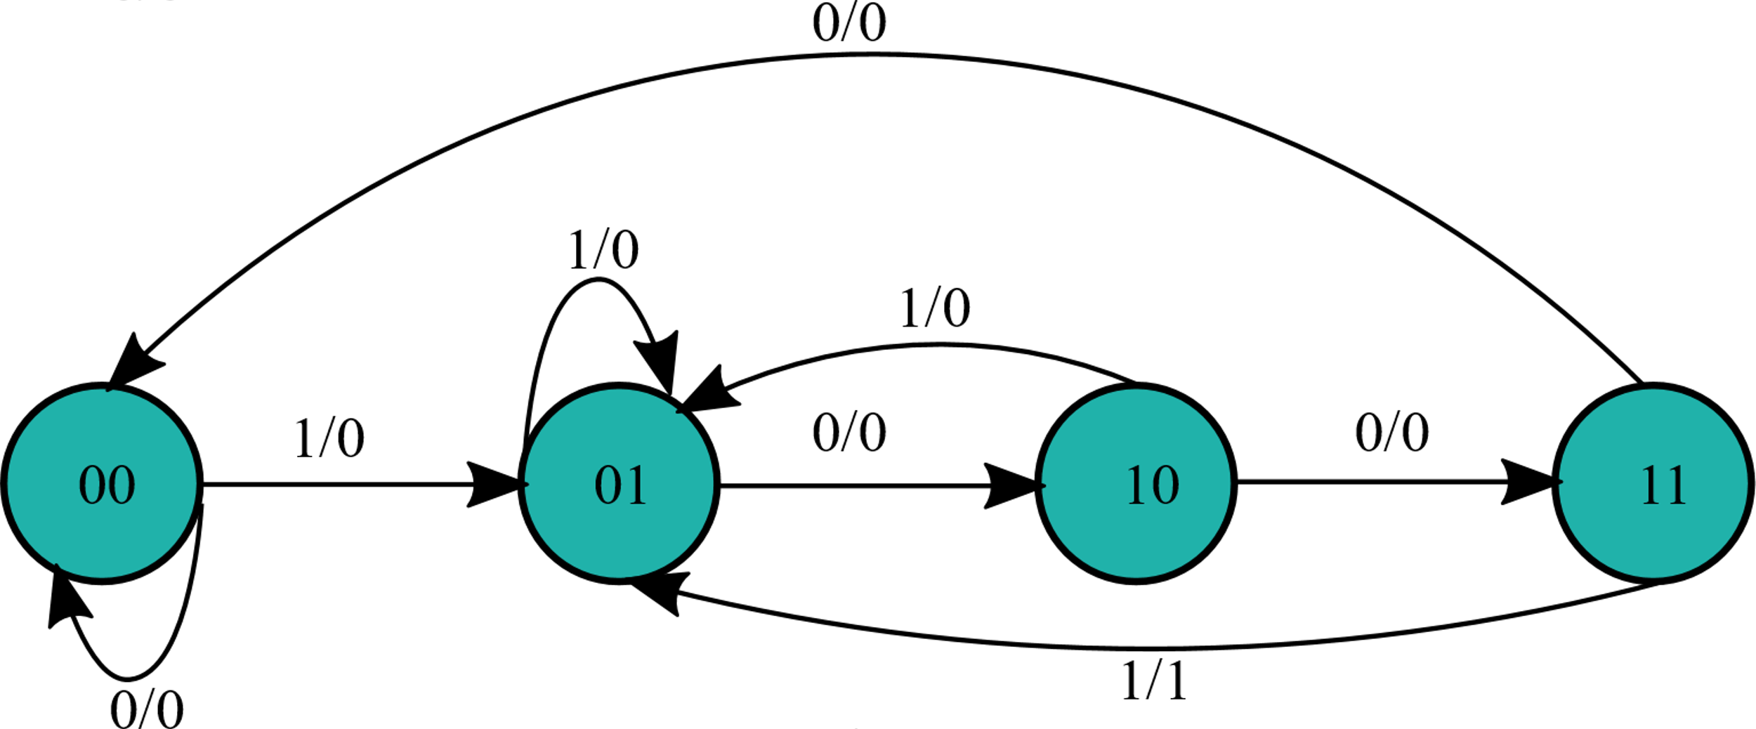
Sequence Detector
Once you obtain the state diagram, assign binary values to the states
A -> 00
B -> 01
C -> 10
D -> 11
Now convert the above state diagram to state table and obtain the logic diagram with D flip flops

